Slide 1


Part 1: Guidance for Vaccinating Individuals with Intellectual and Developmental
Disabilities (I/DD)
Presented by:
The Virginia Department of Behavioral Health and Developmental Services
The Office of Integrated Health
Health Supports Network

Slide 2
Planning Considerations
Planning Considerations

Slide 3
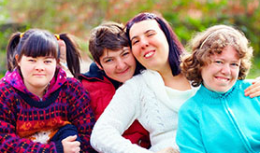
Things to Consider
This training summarizes what clinic organizers should consider when planning to host a vaccination clinic for individuals with intellectual and developmental disabilities living in the community.
It also provides considerations to help ensure equal access and opportunities.

Slide 4
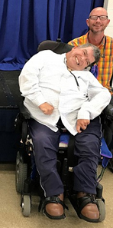
Planning Considerations
  Consider offering special blocks of time at various times of the day, for individuals who may need extra assistance.
  Consider special pre and post vaccine waiting locations for individuals who may be medically fragile, in order to reduce possible exposure to COVID-19
  Consider allowing extra time before and after the vaccination appointment.

Slide 5
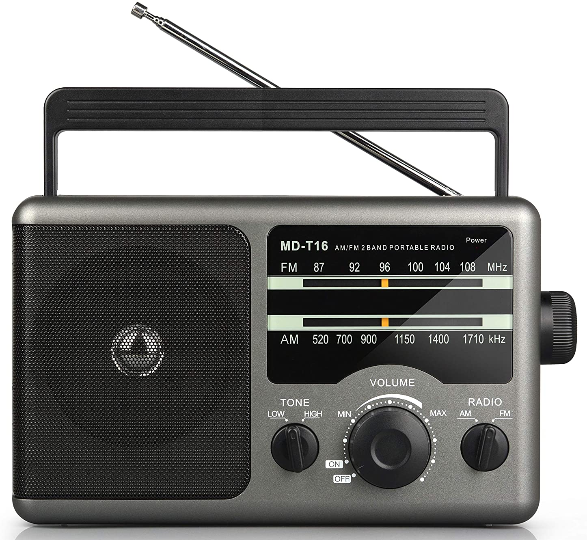



Announcements to the Public
Once the date is decided upon, consider using a range of media channels to communicate information about the vaccination clinic, such as:
Newspaper.
Radio.
TV.
Online and social media channels.
Remember to:
Provide text-only web pages or alt text for screen readers.
Offer dedicated hotlines for questions.
Translate materials into other languages.
Ensure websites meet Web Accessibility Initiative Guidelines.

Slide 6

Anticipate
Scheduling Challenges
Provide help with pre-scheduling for those caregivers or individuals who need it.
Provide other scheduling options in addition to web-based forms.
Create forms which are easy to navigate and complement those of other vaccination clinics and providers in your area or create a common form where possible.

Slide 7
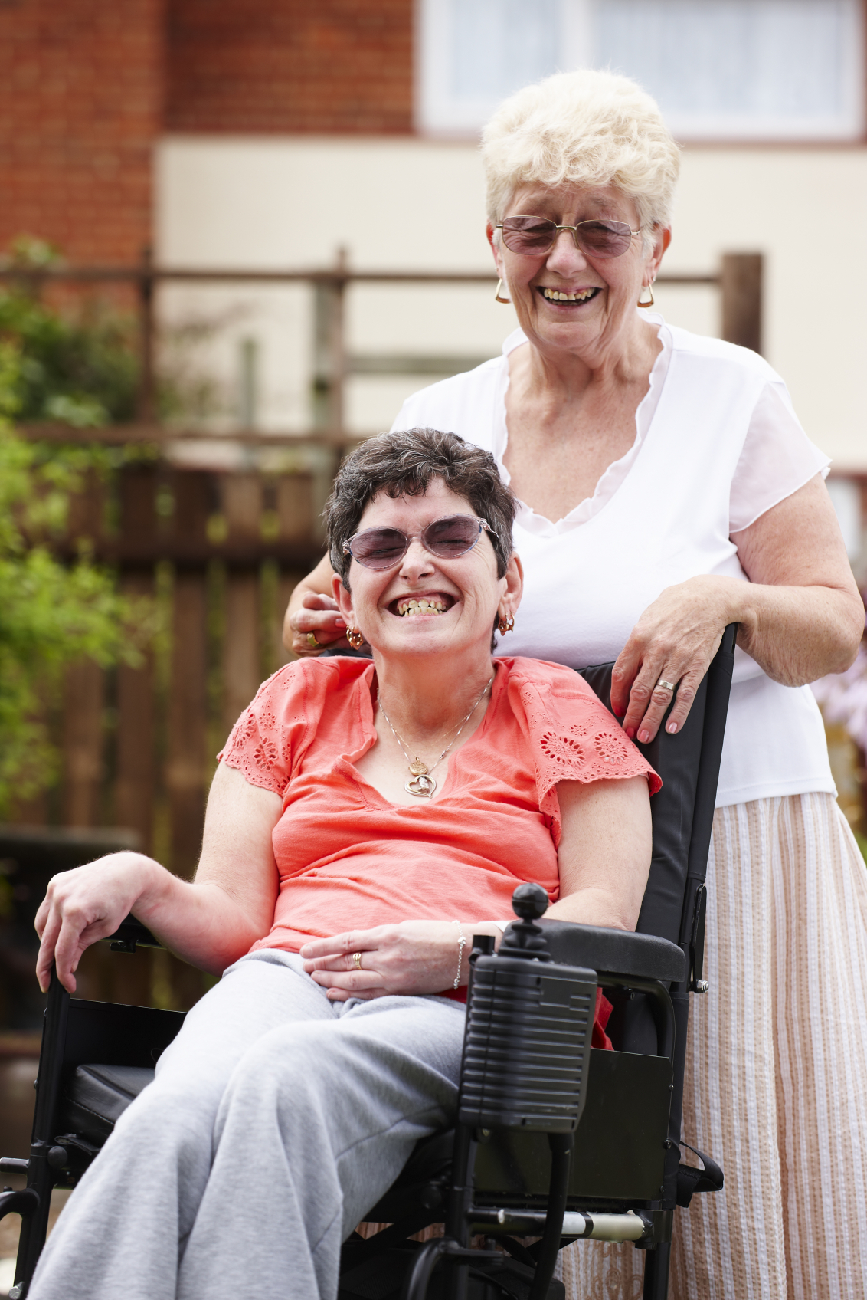
Anticipate Scheduling Challenges
Encourage caregivers to fill out forms ahead of time.
Name a point of contact within a vaccination clinic to address reasonable accommodation needs for individuals with intellectual and developmental disabilities.
If family members or other caregivers will be accompanying the person being vaccinated, ask if they will need to be vaccinated on the same day as the individual.

Slide 8
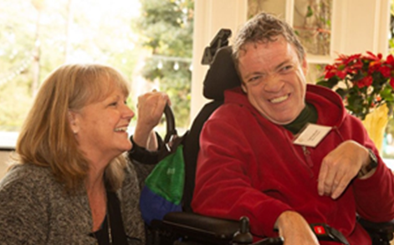
Informed Consent Information
More information about informed consent, authorized representatives and legal guardians can be found here:
§ 54.1-2970. Medical treatment for certain persons incapable of giving informed consent.
12VAC35-115-146. Authorized representatives.
12VAC30-110-1380. Authorized representatives for individual age 18 or older.

Slide 9
Accessibility at the Site
Many individuals with intellectual and developmental disabilities may have cognitive, sensory, mobility and challenges accessing COVID-19 vaccination clinics and warrant specific considerations to support equitable vaccine access.
Ensure vaccination sites are consistent with disability rights statutes such as the Americans with Disabilities Act and Section 504 of the Rehabilitation Act of 1973.
Identify accessible transportation providers in your area, and provide information to participants and their caregivers on how to schedule accessible transportation appointments if needed.

Slide 10

Ensure Equitable Access to All
Confirm accessible:
Parking spaces;
Automatic door openers;
Wheelchair ramps;
Handrails;
Extra space for service animals who accompany individuals.
Electrical outlets for adaptive equipment, which may need to be recharged (communication devices, powered wheelchairs, etc.).
Notes:
https://www.cdc.gov/vaccines/covid-19/clinical-considerations/older-adults-and-disability/access.html

Slide 11


Ensure Adequate Space
Extra space may be needed for:
Individuals who will not keep their face masks on due to sensory and cognitive issues.
Electrical outlets for adaptive equipment, which may need to be recharged (communication devices, powered wheelchairs, etc.)
Caregivers who accompany individuals.
Service animals who accompany individuals.
Notes:
https://www.cdc.gov/vaccines/covid-19/clinical-considerations/older-adults-and-disability/access.html

Slide 12
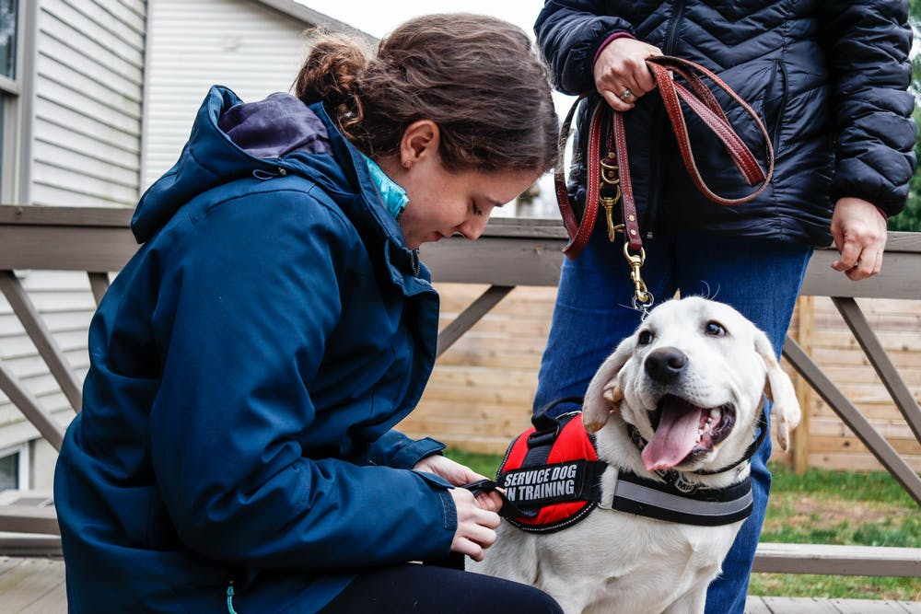
Considerations for Service Animals
Remind staff that service animals must be allowed in the clinic and remain with their handlers.
For more information on service animals, please go to this ADA link: https://www.ada.gov/service_animals_2010.htm

Slide 13
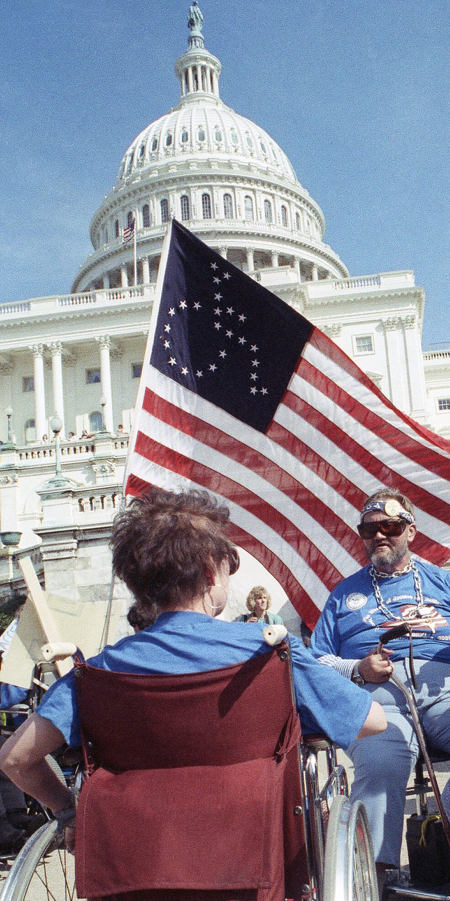
Adaptive Communication
Ensure all communication at the site meets the necessary requirements of the:
Americans with Disabilities Act.
Rehabilitation Act.
Plain Language Act.
Patient Protection and Affordable Care Act.
Any other applicable disability rights laws for accessibility throughout the vaccination process.

Slide 14
Communication
Issues to Consider
Consider vision, hearing and cognitive disabilities, etc. to help ensure all information is useful.
Provide information available in easy-to-read language and in a variety of accessible formats, such as braille, large bold text and pictures or visual stories.
Have interpreters available for non-English languages and American Sign Language.
Speak loudly and slowly for those who may have difficulty hearing or understanding.
Ensure you have personnel on each shift who have experience working with people with disabilities.

Slide 15
Helpful Tips for Bathroom Accommodations
Some individuals with intellectual disabilities may be incontinent. This poses a problem when they are in a public area and they have a wet or soiled brief. (Most bathrooms do not have changing tables big enough for an adult.)
In lieu of a changing table, if there is a room you can provide where they can be changed, it would be extremely beneficial to both the caregivers and the individuals.
Having plastic bags with ties and a special container for soiled briefs or other items may be helpful.*
*These tips may also be helpful for moms with toddlers, women and aging Virginians.

Slide 16

Thank You from the Office of Integrated Health (OIH) at the Virginia Department of Behavioral Health and Developmental Services (DBHDS)
If you have any questions or concerns send them to communitynursing@dbhds.virginia.gov

Slide 17
References
Centers for Disease Control and Prevention (2020). V-safe After Vaccination Health Checker. https://www.cdc.gov/coronavirus/2019-ncov/vaccines/safety/vsafe.html
Jefferson Health (2021). Vaccine visual story, file:///C:/Users/dha92624/Documents/COVIDVaccineVisualStory.pdf
Self Advocacy Resource and Technical Assistance Center (2020). COVID-19-Vaccine-Information-in-Plain-Language.pdf. https://selfadvocacyinfo.org/wp-content/uploads/2020/12/COVID-19-Vaccine-Information-in-Plain-Language.pdf
The Center for START Services at the University of New Hampshire Institute on Disability/UCED (2021). Kory’s Story: Getting the COVID-19 Vaccine. https://centerforstartservices.org/sites/www.centerforstartservices.org/files/korysstorygettingthecovid19vaccine.pdf

