Slide 1

Part 2: Guidance for Vaccinating Individuals with Intellectual and Developmental
Disabilities (I/DD)
Presented by:
The Virginia Department of Behavioral Health and Developmental Services
The Office of Integrated Health
Health Supports Network

Slide 2
The Day of the Clinic:
Things to Know
The Day of the Clinic:
Things to Know

Slide 3
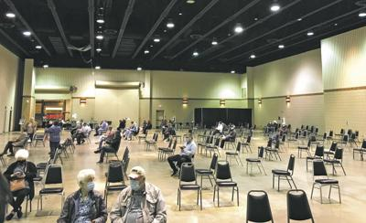
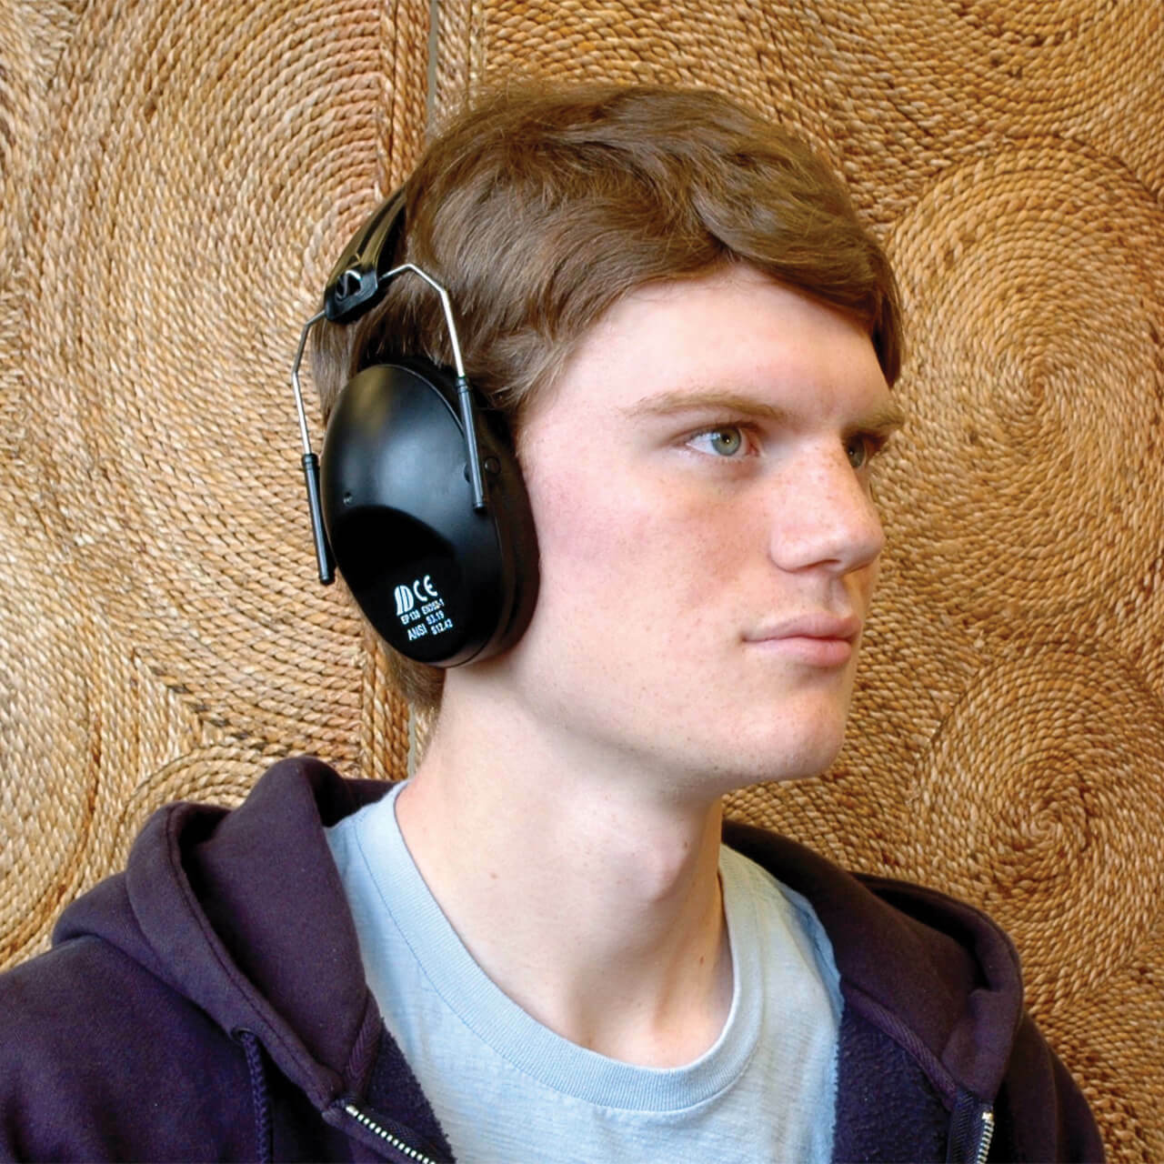
Sensory Issues to Consider
Giving individuals pictorial checklists upon arrival with clear, easy to read information can help individuals and caregivers stay informed and may reduce anxiety on vaccination day.
If the room (auditorium, etc.) cannot be less overwhelming, consider offering noise-reduction headphones and/or sunglasses to reduce sensory overload for individuals.

Slide 4
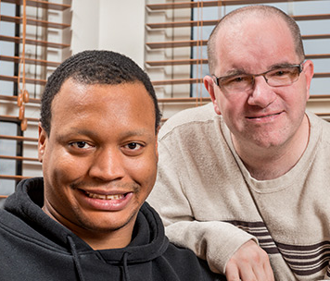
Sensory Issues to Consider
Individuals with intellectual disabilities can sense negativity more easily than the rest of us, so please try to be positive.
No one can see you smile behind your mask, so please use a friendly tone of voice.
Be patient, it make take individuals with I/DD longer to follow directions and/or answer your questions.
Be encouraging, friendly and positive.
Some individuals with I/DD (especially those with autism) may not like to be “touched”. Please be respectful of their personal space.

Slide 5
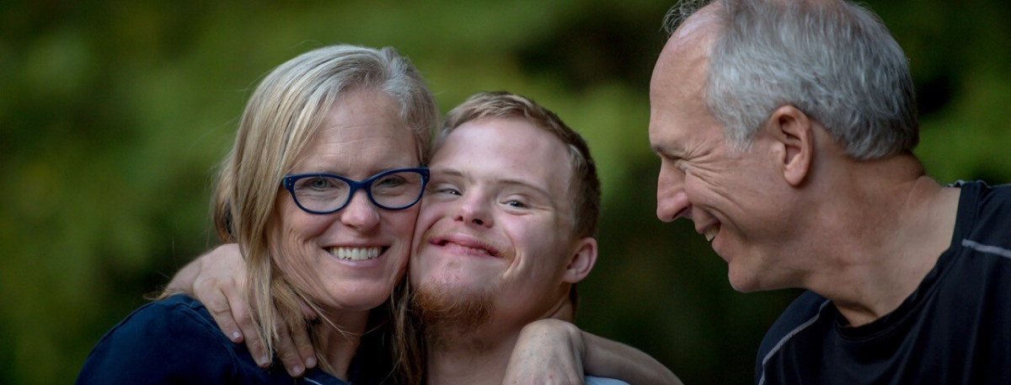
Be Welcoming to Caregivers and Family Members
Most individuals with intellectual and developmental disabilities have caregivers (family members, direct service providers, friends, etc.) who help them with day-to-day activities.
Encourage family members and/or other caregivers to accompany individuals to the vaccination site.
If family members or other caregivers will be accompanying the person being vaccinated, ask if they will need to be vaccinated at the same time, so everyone is accounted for in the schedule.

Slide 6
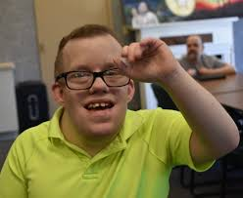
Some Important Things to Know
Here are some things individuals with intellectual and developmental disabilities might want their vaccinators to know:
I might feel anxious, and a new environment with loud noises and bright lights might make this worse.
My caregiver must stay with me to at all times throughout the process to communicate my needs, maintain my safety, and address any of my concerns.
Notes:
The young adults at Carousel Connection put together a list of things people with intellectual disabilities might want their vaccinators to know:

Slide 7
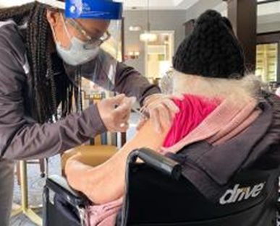
Some Important Things to Know continued…
Distraction helps me.
Tools like fidgets or offering to hold an individual’s hand.
Ask for my caregiver’s help.
Encouragement helps.
Please tell me that I am doing a good job, or that I am being brave and strong.
Be clear about expectations.

Slide 8

Some Important Things to Know continued…
I may not think to start a discussion to distract myself, so please feel free to begin a discussion with me.
Some things you can ask me are my favorite song or activity.
Or even ask me what helps me feel calm.

Slide 9

Tips for Administering
Vaccines continued…
Ask the individual and caregivers if they any questions about the vaccine.
Some people with disabilities may have questions or concerns, which are not common among other people.
Have accessible materials on site which gives more information about the vaccine, any potential side effects, and when the vaccinated person needs to return for a second dose, if needed.
A reward or a sticker at the end always helps.

Slide 10
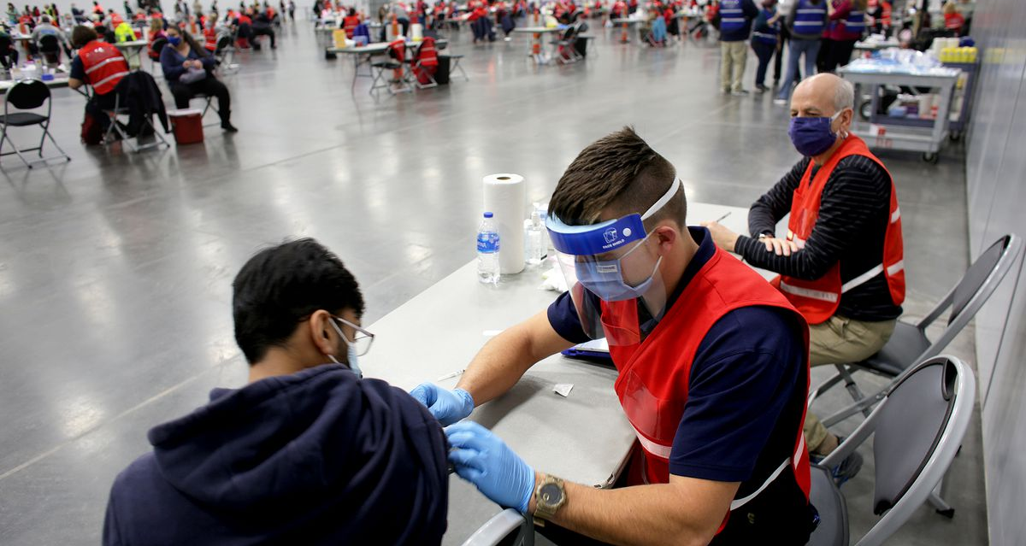
Share Personal Experiences of
Individuals with Intellectual Disabilities
You can download a Vaccination Visual Story from Jefferson Hospital here: https://hospitals.jefferson.edu/content/dam/health/PDFs/departments/COVIDVaccineVisualStory.pdf
You can download a copy of Kory’s Story: Getting the COVID-19 Vaccine here: https://centerforstartservices.org/sites/www.centerforstartservices.org/files/korysstorygettingthecovid19vaccine.pdf

Slide 11
After the Vaccine
After the Vaccine

Slide 12
Special Accommodations:
After the Vaccine
Monitor for allergic reactions for 15-30 minutes, per CDC guidance. (Please remember: I/DD individuals may not understand abstract concepts such as: headache, nausea, dizziness, etc.)
Provide accessible information about whom to call if the person has questions or concerns post vaccination.
  Consider providing chairs that rock, or sensory spaces people can use for their 15-minute wait. They can all be great resources, assuming they can be sanitized and kept COVID-19 safe.
If I am waiting and being watched for 15 minutes, please give me updates on the time.

Slide 13

The Second Vaccine Dose
Schedule the vaccination appointment for the second dose, if one is needed, (if not already scheduled).
Ask the individual and caregiver if they have any questions or concerns about scheduling for their second dose.
Develop a plan to remind people about the second-dose appointment, when needed.
Encourage the person who was vaccinated to sign up for V-safe, CDC’s after vaccination health checker.

Slide 14
Additional Resources
Additional Resources

Slide 15
Support
Organizations for More Information
Reach out to partner organizations who serve individuals with intellectual and developmental disabilities, such as:
The Virginia Department of Behavioral Health and Developmental Services (DBHDS).
Other state agencies on aging and disabilities.
Centers for Independent Living.
Community-based organizations and advocacy groups.
Veterans’ groups.
Faith-based organizations.
Tribal organizations, and others to identify vaccine needs and accessible locations.
Notes:
Partner Organizations for Individuals with Disabilities in Virginia
The Department of Behavioral Health and Developmental Services (DBHDS)
The Office of Integrated Health at DBHDS
Developmental Services
Office of Recovery Services
Human Rights
Substance Abuse Services
Behavioral Health and Wellness
Centers for Independent Living
Virginia Board for People with Disabillities
Virginia Board for People with Disabilities
Center for Disability Leadership
The Arc of Virginia
Department of Medical Assistance Services (DMAS)
CommonHelp (apply for Medicaid)
Medicaid.gov Virginia page
Virginia Department of Health
Virginia Department of Behavioral Health & Developmental Services
Virginia Disability Services Agencies
Virginia Easy Access
Virginia Navigator
Virginia Department of Social Services
Secretary of Health and Human Resources
Partnership for People with Disabilities
Virginia Department for Aging and Rehabilitative Services
Virginia Department of Medical Assistance Services (DMAS)
Virginia Assistive Technology System (VATS)
Virginia Office of Children's Services
Virginia Department of Health
Virginia Department of Behavioral Health & Developmental Services
Virginia Disability Services Agencies
Virginia Easy Access
Virginia Navigator
Virginia Department of Social Services
Secretary of Health and Human Resources
Partnership for People with Disabilities
Virginia Department for Aging and Rehabilitative Services
Virginia Department of Medical Assistance Services (DMAS)
Virginia Assistive Technology System (VATS)
Virginia Office of Children's Services
Virginia Department of Health
Virginia Department of Behavioral Health & Developmental Services
Virginia Disability Services Agencies
Virginia Easy Access
Virginia Navigator
Virginia Department of Social Services
Secretary of Health and Human Resources
Partnership for People with Disabilities
Virginia Department for Aging and Rehabilitative Services
Virginia Department of Medical Assistance Services (DMAS)
Virginia Assistive Technology System (VATS)
Virginia Office of Children's Services
Office of Developmental Services
Community Support Services
Vocational Rehabilitation
Employment Services & Special Programs (ESSP)
disAbility Navigator
The Arc of Virginia
Office of Mental Health - Virginia Department of Behavioral Health & Developmental Services
Governor's Access Plan (GAP)
Mental Health America of Virginia
Vocational Rehabilitation
disAbility Navigator
Traumatic Brain Injury
Brain Injury Association of Virginia
Virginia Brain Injury Council (VBIC)
Vocational Rehabilitation
Employment Services & Special Programs (ESSP)
disAbility Navigator
Addiction Services
Office of Substance Abuse Services (OSAS)
Substance Abuse & Addiction Recovery Alliance (SAARA)

Slide 16
Resources
Free Online Trainings & Webinars
Strategies for Addressing Anxiety Related to COVID-19 (AUCD Webinar recorded 6.24.2020) - Dr. Karen Weigle, Associate Director, and Dr. Jill Hinton, Clinical Director, Center for START Services
COVID-19 Toolkit for DSPs (NADSP)- Resources to help DSPs take care of themselves during the Crisis
MH Treatment Approaches in a World with COVID: You can do it! with Dr. Katy Stratigos (Virtual SNTI May 2020) - Q&A with Dr. Stratigos
The Science of Hope in a Time of Crisis (START/AUCD Webinar recorded 4.15.2020) - Dr. Dan Tomasulo
Violence & Mental Illness: The Real Story (AUCD Webinar recorded 9.26.2019) - Dr. Jill Hinton, Center for START Services Clinical Director
Mental Health Diagnosis in IDD: Bio-psycho-social Approach (AUCD Webinar recorded 10.18.2017) - Dr. Roberto Blanco, NC START Medical Director & Dr. Jill Hinton, Center for START Services Clinical Director
Trauma-Informed Care Throughout the Lifespan (AUCD Webinar) - Dr. Jill Hinton, Center for START Services Clinical Director
Mental Health Wellness for Individuals with Intellectual and Developmental Disabilities (MHW-IDD) a free 6 module training from Texas Health and Human Services developed in partnership with Dr. Joan B Bealsey, Center for START Services Director
Trauma Informed Care: Perspectives and Resources: A comprehensive web-based, video-enhanced resource tool from Georgetown University's National Technical Assistance Center for Children's Mental Health

Slide 17
Resources
Parent, Family, Caregiver Resources
Family Matters Toolkit by HCARDD - This toolkit is for caregivers who are interested in improving the health and health care of a family member with intellectual and developmental disabilities (IDD). The resources included in this toolkit can be used together, or as stand-alone materials, depending on your needs, goals and existing resources.
Health Care Resources for People with DD and Caregivers (Health Passports, Communication Tools, About Going to the Hospital) by HCARDD
Autism-related materials from the Vanderbilt Kennedy Center. Publications include tip sheets, booklets, and more available through the Vanderbilt Kennedy Center and its affiliates.
Autism resources for parents from Autism Speaks
STOMP: Stopping the over medication of people with a learning disability, autism or both easy read leaflet from NHS England
Genetics education materials for parents and schools from GEMSS
Developmental Monitoring and Screening from the CDC (in English and En español)
Healthcare Provider Resources
Healthcare for Adults with Intellectual and Developmental Disabilities: A Toolkit for Primary Care Providers from the Vanderbilt Kennedy Center
Free Webinars from the National Academy of Developmental Medicine and Dentistry
Autism related resources for healthcare professionals from Autism Speaks
Genetic education materials for school success (GEMSS) resources for healthcare providers
Improving Emergency Care for adults with Developmental Disabilities: A Toolkit for Providers from HCARDD
Implementing Health Checks for Adults with Developmental Disabilities: A Toolkit for Primary Care Providers from HCARDD

Slide 18
Resources
Health Care Provider Resources - Positive Psychology Resources
UPenn Authentic Happiness Website
PERMA infographic from PositivePsychologyProgram.com
Positive psychology books written by leaders in the field
VIA Institute on Character
The Positive Psychology Center
The Greater Good Science Center at UC Berkeley
Greater Good in Action: Science-based practices for a meaningful life
VIA Institute on Character
Websites & Organizations
AUCD Mental Health Aspects of IDD Special Interest Group - The Mental Health Aspects of I/DD Special Interest Group (MH SIG) at AUCD provides information to Network members on critical issues related to mental health for people with intellectual and/or developmental disabilities
Mental Health and Developmental Disabilities National Training Center
Mental Health –Intellectual and Developmental Disabilities (1998-2009) - Former groundbreaking journal in IDD-MH developed by Anne Hurley PhD and Robert Sovner MD that continues to offer valuable information today
National Center for Trauma-Informed Care (NCTIC) a program of the Substance Abuse and Mental Health Services Administration (SAMHSA)
National Center for Cultural Competence at Georgetown University
Center for Child and Human Development at Georgetown University
Hogg Foundation for Mental Health at the University of Texas at Austin (Read: Policy

Slide 19
Resources
Websites & Organizations
Recommendations: Addressing the Mental Health and Wellness of Individuals with Intellectual Disabilities (IDD))
The Positive Psychology Center at the University of Pennsylvania
American Association on Intellectual & Developmental Disabilities (AAIDD)
American Academy of Developmental Medicine and Dentistry (AADMD)
Association of University Centers on Disabilities (AUCD)
National Disability Navigator Resource Collaborative
Genetics Education Materials for School Success (GEMSS) a program from the New England Regional Genetics Network (nergn)
Centers for Disease Control and Prevention (CDC)
American Academy of Child & Adolescent Psychiatry (AACAP)
US National Library of Medicine MedlinePlus

Slide 20
References
Centers for Disease Control and Prevention (2020). V-safe After Vaccination Health Checker. https://www.cdc.gov/coronavirus/2019-ncov/vaccines/safety/vsafe.html
Jefferson Health (2021). Vaccine visual story, file:///C:/Users/dha92624/Documents/COVIDVaccineVisualStory.pdf
Self Advocacy Resource and Technical Assistance Center (2020). COVID-19-Vaccine-Information-in-Plain-Language.pdf. https://selfadvocacyinfo.org/wp-content/uploads/2020/12/COVID-19-Vaccine-Information-in-Plain-Language.pdf
The Center for START Services at the University of New Hampshire Institute on Disability/UCED (2021). Kory’s Story: Getting the COVID-19 Vaccine. https://centerforstartservices.org/sites/www.centerforstartservices.org/files/korysstorygettingthecovid19vaccine.pdf

Slide 21

Thank You from the Office of Integrated Health (OIH) at the Virginia Department of Behavioral Health and Developmental Services (DBHDS)
If you have any questions or concerns send them to communitynursing@dbhds.virginia.gov

