Slide 1

Aspiration Pneumonia
Risk Awareness Training (RAT)
Presented by:
The Virginia Department of Behavioral Health and Developmental Services
The Office of Integrated Health
Health Supports Network

Slide 2
Who benefits from this training
DSP's and caregivers- you will learn important risk factors associated with aspiration pneumonia, learn to recognize signs and symptoms, and the importance of reporting.
Support Coordinators-you will learn important risk factors associated with aspiration pneumonia, understand the signs and symptoms that DSP's and caregivers are going to recognize and provide in documentation, and diagnosis that may be associated with risk factors.

Slide 3
Training Objectives
Define Aspiration Pneumonia
Identify (4) risk factors for Aspiration Pneumonia
State (4) signs and symptoms of Aspiration Pneumonia
Name (1) diagnostic tool to diagnose Aspiration Pneumonia.
Identify (1) long-term complication of Aspiration Pneumonia.
List (1) recommendation for preventing Aspiration Pneumonia.

Slide 4
Terms and Definitions
Aspiration-Aspiration occurs when a person accidentally inhales particles into their airway.
Pneumonia-Pneumonia is an infection that inflames the air sacs in one or both lungs. The air sacs may fill with fluid or pus (purulent material), causing cough with phlegm or pus, fever, chills, and difficulty breathing. A variety of organisms, including bacteria, viruses and fungi, can cause pneumonia.
Dysphagia- is defined as difficulty swallowing and may involve obstructive or motor disorders.
Blood tests. Blood tests are used to confirm an infection and to try to identify the type of organism causing the infection.
Chest X-ray. This helps your doctor diagnose pneumonia and determine the extent and location of the infection. A chest x-ray can't tell the physician what kind of germ is causing the pneumonia.

Slide 5
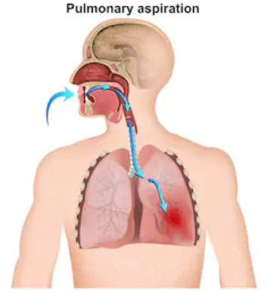
What is
Aspiration Pneumonia?
Aspiration pneumonia is an acute lung infection that occurs when food, drink, vomit or saliva has been inhaled into the lungs. Aspiration is more likely if something disturbs your normal gag reflex, such as a brain injury or a swallowing problem such as dysphagia (Sullivan & Roland, 2019).

Slide 6
Risks Factors for Aspiration Pneumonia
Dysphagia, or difficulty swallowing.
Difficulty controlling head or neck muscles (cerebral palsy).
Mobility limitations that prevent sitting up straight.
Impaired consciousness or awareness.
GERD, or Gastroesophageal reflux disease.
Eating too quickly or putting too much food in one’s mouth.
Dental problems that prevent adequate chewing (edentulous).
Anatomical variation such as a small airway or a large tongue.
Age (Dementia).
Stroke.
Upper Gastrointestinal Disorders
Assistance to be fed.
History of choking.
Feeding tube (G-tube, NG-tube, J-tube)
(Sullivan & Roland, 2019) & (Marik, 2001)
Notes:
Individual's are often prescribed medications that make Individuals drowsy such as seizure medications and psychotropic medications
Dysphagia- Altered textured diet and drink modification. Very important to follow the textured and consistency ordered, deviation from the order puts the Individual at very high risk.
Gastrointestinal Disorders-Has a diagnosis of Hiatal Hernia, Gastroparesis, Peptic Ulcer, Crohns Disease,
Irritate Bowel Syndrome, Irregular Cleft Palate

Slide 7
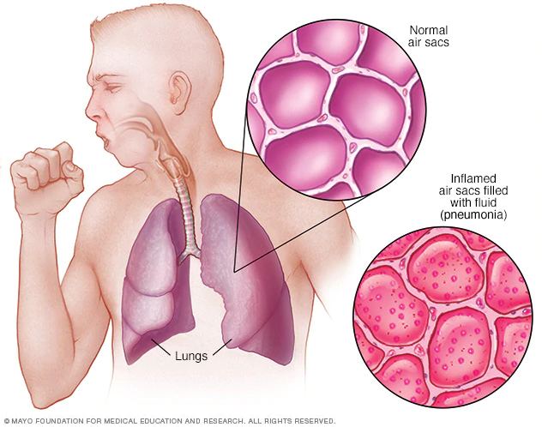
Aspiration Pneumonia
Inflamed air sacs filed with fluid = Pneumonia

Slide 8
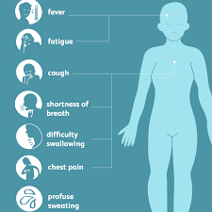
Signs and symptoms
Aspiration
Sudden coughing, wheezing, or hoarseness
Drooling
Changes in breathing patterns
Regular coughing or sneezing while eating
Gurgling sounds or voice after eating
Excessive throat clearing
Pneumonia
Chest pain
Shortness of breath
Wheezing
Fatigue
A blue tinge to the face or lips
Cough, especially involving bloody or green sputum
Bad breath
Difficulty swallowing
Perspiration
Fever
(Gamache, 2018)

Slide 9
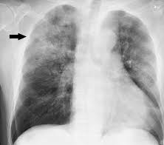
Diagnosing
Blood tests. Blood tests are used to confirm an infection and to try to identify the type of organism causing the infection.
Chest X-ray. An x-ray helps your doctor diagnose pneumonia and determine the extent and location of the infection. A chest x-ray can't tell the physician what kind of germ is causing the pneumonia.
Pulse oximetry. This measures the oxygen level in the blood. Pneumonia can prevent the lungs from moving enough oxygen into the bloodstream.
Sputum test. A sample of fluid from the lungs (sputum) is taken after a deep cough and analyzed to help pinpoint the cause of the infection.

Slide 10
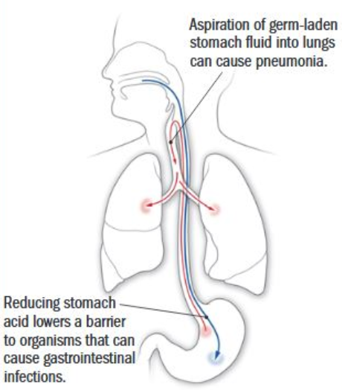
Treatment
Treatment for aspiration pneumonia depends on the severity of the pneumonia, general health status, and pre-existing conditions. Severe cases may require hospitalization. If the underlying cause is due to dysphagia the individual may be put on NPO "Nothing by Mouth" until a plan can be determined. Assessment by a gastroenterologist and Speech Pathologist will be required.
Antibiotic medication
Supplemental Oxygen
Surgery
Nasogastric tube
Steroids
HOB elevated (Sanivarapu & Gibson, 2020)

Slide 11
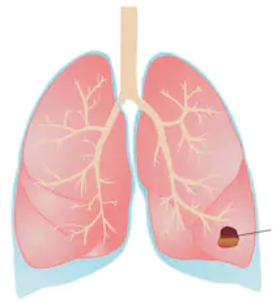
Long-term Outcomes
Complications from aspiration pneumonia are as follows
Lung abscess
ARDS (Acute Respiratory Distress Syndrome)
Spread of infection to the blood stream (bacteremia)
Respiratory failure
Empyema
Parapneumonia Effusion
(Sanivarapu & Gibson, 2020)

Slide 12
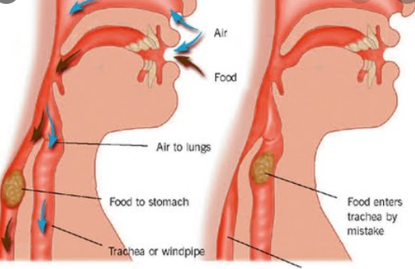
Aspiration and Dysphagia
Dysphagia is defined as difficulty swallowing and may involve obstructive or motor disorders (O’Toole, 2013).
The terms dysphagia and swallowing disorder are used interchangeably.
Dysphagia may involve difficulty with sucking, chewing, swallowing foods, liquids or medications, controlling saliva, and protecting the airway (International Dysphagia Diet Standardization Initiative [IDDSI], 2016).
The act of swallowing involves several intricate steps with a number of muscles propelling food downward from the mouth to the stomach (U.S Department of Health and Human Services, 2017)

Slide 13
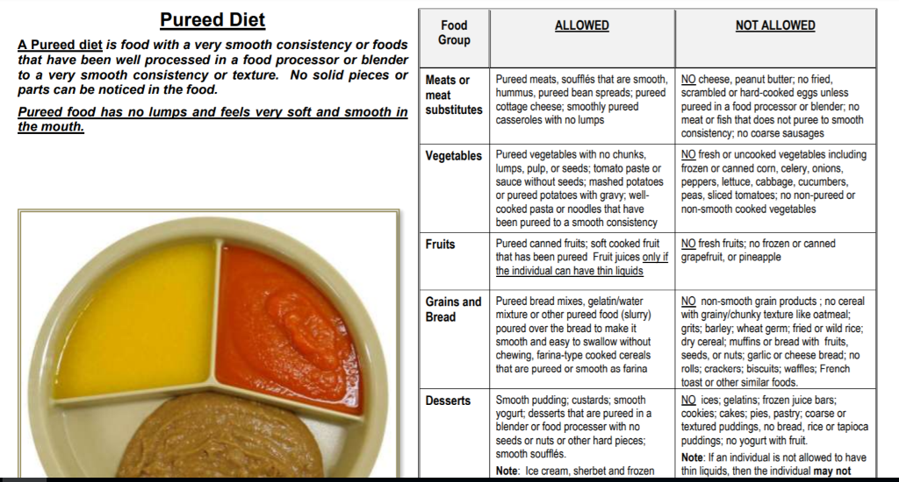
Modified Diets
Based on the severity of dysphagia, individuals may be placed on a modified diet. This is an example of a Pureed Diet. Recommendations from a Speech Language Pathologist following a barium swallow study will help ensure the individual is eating food/drink that is prepared to meet their dysphagia needs.

Slide 14
Positioning Protocols
Protocol Example
Provide a quiet setting at mealtimes to reduce the number of distractions.
Order for pureed diet consistency with honey-thickened liquids.
Prepare food and liquid according to orders.
Ensure seating position that offers the best support is sitting upright, chin slightly tucked, with head tilted to the left, body should be in alignment with feet resting on the foot pedals.
Can feed self by using scoop plate, weighted spoon, and two handled cup. Please make sure all of these are available each meal.
Provide reminders during the meal to eat slowly, taking a drink between bites.
Provide reminders to swallowing twice after each bite.
Provide reminders to tuck the chin and tilt head to the left side.
Remain in the upright position for 2 hours after meals.
Each person will need to be evaluated to determine the best body position for safe eating. An evaluation by a Speech Pathologist will give guidance for positioning. A protocol should be written using the (SP) assessment information. These are just examples of what you might see incorporated in a Protocol. (Kagaya, H., Inamoto, Y., Okada, S., Saitoh, E. (2011).

Slide 15

Importance of Reporting Change
Aspiration can present with signs and symptoms or it can be silent.
Individuals with intellectual and developmental disabilities are at higher risk for aspiration.
  For example, individuals with Down Syndrome have a greater risk of dying from Aspiration Pneumonia (Jasien, et.al.,(2016).
Document your observations in daily note and who it was reported to.

Slide 16

DSP's connect the dots......
Situation: Gary is enjoying his lunch with peers at DS. You notice that he takes a gulp of drink and now he is coughing and stretching his neck upward. He keeps clearing his throat and making rubbing his throat. You've noticed the coughing during meals all week, but today is more intense. You staff this with your supervisor and agree this is a noticeable change.
This event would require a CHRIS report and would be included in the Quarterly Review
Example only: Follow your agency documentation standards.
Example of a daily note: 4/9/20 Gary had difficulty drinking at lunch today. He started coughing, stretching his neck upward, and making noise clearing his throat. DSP notified direct supervisor.
Way to go DSP! You recognized and reported.

Slide 17
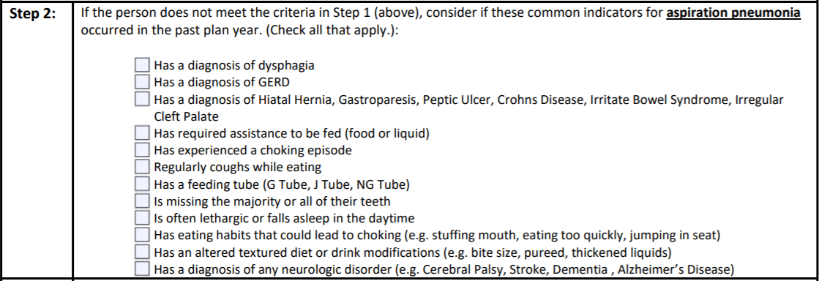
DSP's connect the dots....
Use the RAT tool to help staff be aware of risks and also prompt changes that need to occur with plans and support instructions. The RAT can help providers be proactive.
You are the boots on the ground. Based on your daily observations you may recognize a change in status that would require evaluation. If you notice any of the risk factors listed below for aspiration pneumonia, report and document it quickly.

Slide 18
Recommendations
Anyone with a history of aspiration pneumonia or risk factors that increase the likelihood of aspirating should have a protocol to address specifics to that individual.
Protocols require approval from a medical professional.
Staff will require training on assistance level during meals the individual will need to eat safely.
Positioning Protocol for mealtimes should be written based on SLP recommendations.
Adaptive feeding equipment (plates, utensils, cups) in all settings as prescribed.
Staff training on signs of aspiration, what to do, where to document, and who to notify if an event occurs.
Good oral hygiene to decrease bacteria in the mouth that could get aspirated into the lungs.
Seek medical assessment quickly, aspiration pneumonia can lead to sepsis.

Slide 19
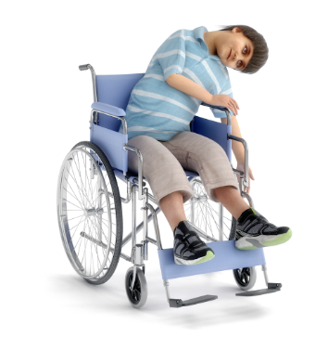
Case Study - Meet Joe
Joe is a wonderful, fun loving person. He enjoys watching people from afar. He especially likes mealtimes and eating with his peers and becomes distracted easily. Joe eats with minimal intervention. He will overfill his mouth if he feels rushed during meals. Although Joe is non-verbal, he has good receptive skills. In the past, to get his needs met, Joe has refused to eat.
Over the past few days, you have noticed that Joe is not finishing all his meals. He appears to be unhappy at mealtimes, which is very unusual. He attempts to put his fist in his mouth. He will take a few bites of food, but then stretches his head upward. He has been coughing at mealtimes too. You assumed if he was choking, he would not be able to cough. Joe is leaning more to left side than before (he has severe scoliosis), you try to use a pillow to keep him upright.

Slide 20
Apply what you’ve learned
What are three (3) interventions that could be utilized to help Joe.
1. ____________________________
2. ____________________________
3. ____________________________

Slide 21
SC's connect the dots...
SC's- as you are completing the RAT tool keep in mind there are key diagnoses and situations you need to incorporate in discussion with providers and caregivers to ensure risk factors are being recognized.
Excessive saliva increases the risk of aspirating bacteria into the lungs.
Medications that cause an Individual to be sleepy or drowsy at mealtime. Check medications side effects for drowsiness.
Look at Individual's medical history for esophageal dilation due to esophageal stricture.
Individual's that require assistive devices to eat such as special utensil. Are at risk if guidelines are not followed.
RAT TOOL
Look for diagnosis such as Barrette's Esophagus.
Look for diagnoses of Prader Willi's and PICA
Individual's diagnosed with Down Syndrome can develop Dementia earlier in life than the general population
Tardive dyskinesia can cause excessive tongue movements making eating difficult.

Slide 22

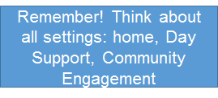
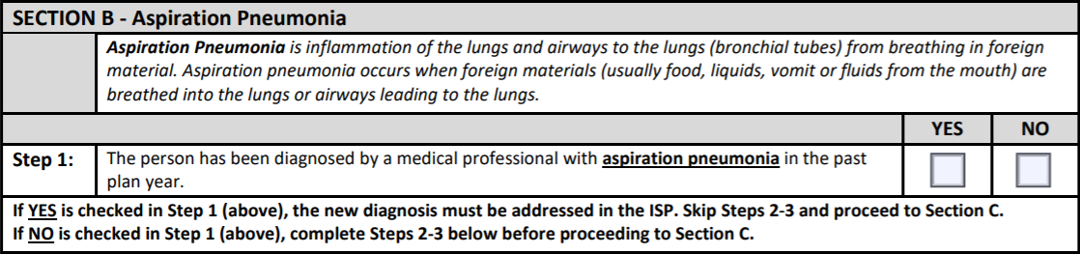

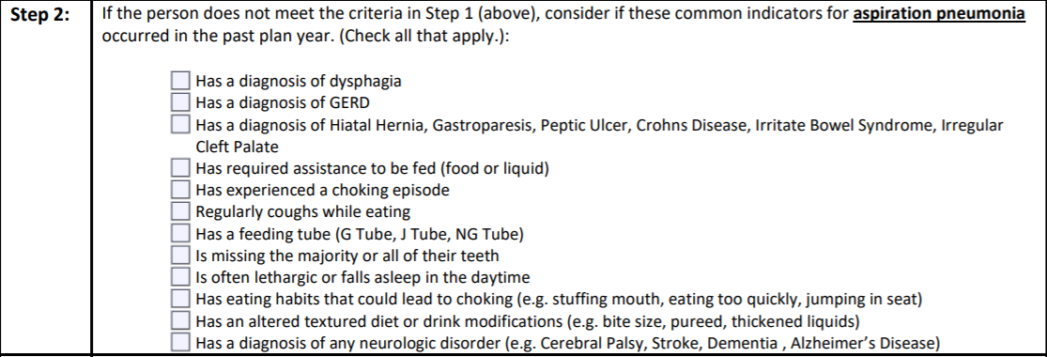
Follow these steps to success...
Skip Step 2 and go to Section C

Slide 23
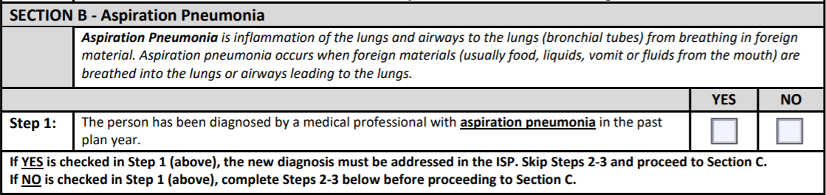
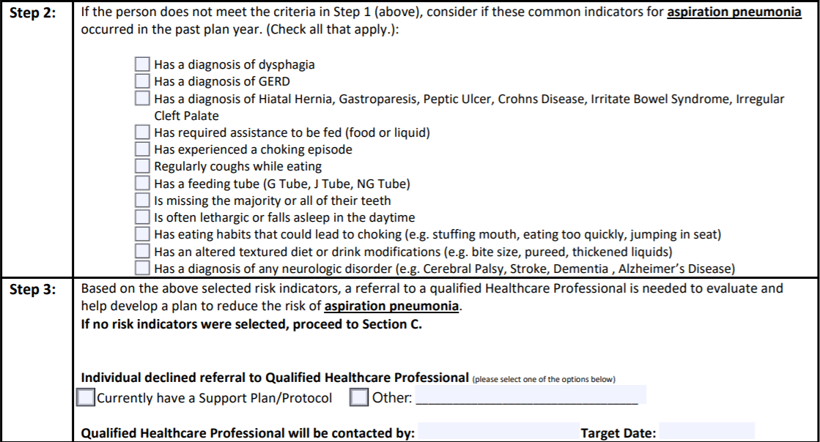
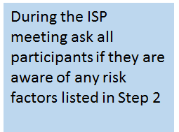


Follow these steps to success...

Slide 24
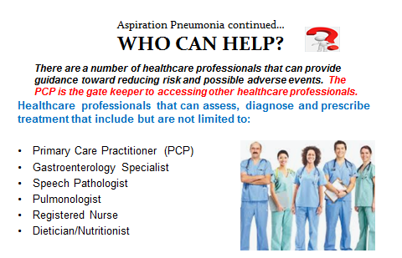

Slide 25
Resources
Relias The Fatal Four In Idd: Aspiration’s Dangers And Key Interventions https://www.relias.com/blog/the-fatal-four-aspiration-dangers-and-key-interventions
Download Fatal Four Posters https://www.relias.com/resource/fatal-four-posters
International Dysphagia Diet Standardization Initiative https://iddsi.org/

Slide 26
References
Chadwick, D., Jolliffe, J., & Goldbart, J. (2003). Evidence based practice: A challenge for speech and language therapists. Caregiver knowledge and barriers to their compliance with dysphagia management strategies. Proceedings of the 5th European PLOL Congress. Edinburgh, UK. Retrieved from file:///C:/Users/dbk75942/Downloads/Dysphagiamanagementforadultswithlearningdisabilities-Fullpaperfor5thEuropeanCPLOLCongress2003.pdf
Gamache, J. (2018). Aspiration pneumonitis and pneumonia. Retrieved from https://emedicine.medscape.com/article/296198-overview#a5
International Dysphagia Diet Standardisation Initiative. (2016). Resources. Retrieved from https://iddsi.org/resources/
Jasien J., Capone G, Silverman W, Shapiro BK, Weadon C, et al. (2016) Signs of Aspiration in Adults with Down Syndrome: Prevalence as Determined Using A Water-Swallowing Screen and Caregiver Report. J Neurol Neurobiol 2(2): doi http://dx.doi.org/10.16966/2379-7150.120 Open Access 2
Kagaya, H., Inamoto, Y., Okada, S., Saitoh, E. (2011). Body positions and functional training to reduce aspiration in patients with dysphagia. JMAJ, 54 (1), 35-38. Retrieved from file:///C:/Users/dbk75942/Downloads/Dysphagia%20Research/Body%20Positioning%20for%20Dysphagia.pdf
Kunst, K., Heinzerling, S., & University of North Carolina. (2020, March 20). The Fatal Four in IDD: Aspiration's Dangers and Key Interventions. Retrieved from https://www.relias.com/blog/the-fatal-four-aspiration-dangers-and-key-interventions
Marik, P. E. (2001). Aspiration Pneumonitis and Aspiration Pneumonia. New England Journal of Medicine, 344(9), 665–671. doi: 10.1056/nejm200103013440908
Mayo Clinic. (2018). Pneumonia Retrieved from https://www.mayoclinic.org/diseases-conditions/pneumonia/diagnosis-treatment/drc-20354210
O’Toole, M. (Ed.). (2013). Mosby’s Medical Dictionary (10th ed.). St. Louis, Missouri: Elsevier.
Sanivarapu, R.,& Gibson J. (2020) Aspiration Pneumonia. Retrieved from https://www.ncbi.nlm.nih.gov/books/NBK470459/
Sullivan, D., & Roland, J. (2019). What does aspiration mean? Retrieved from https://www.healthline.com/health/aspiration
U.S. Department of Health and Human Services. National IInstitute of Health. (2017). What is dysphagia. Retrieved from https://www.nidcd.nih.gov/health/dysphagia#:~:text=Swallowing%20is%20a%20complex%20process,making%20it%20ready%20for%20swallowing.

