Slide 1

Constipation and Bowel Obstructions
Risk Awareness Training (RAT)
Presented by:
The Virginia Department of Behavioral Health and Developmental Services
The Office of Integrated Health
Health Supports Network

Slide 2

Objectives
Define constipation
List (2) common causes of constipation
State (2) complications of constipation
Define bowel obstruction
Identify (4) signs and symptoms of fecal impaction
Identify (3) caregiver recommendations
List two medical professionals that can help with assessing for bowel obstruction

Slide 3
DSP's and caregivers- you will learn important risk factors associated with constipation and bowel obstructions, learn to recognize signs and symptoms, and the importance of recognition and reporting.
Support Coordinators-you will learn important risk factors associated with constipation and bowel obsturction, understand the signs and symptoms that DSP's and caregivers are going to recognize and provide in documentation, and learn diagnosis that may be associated with risk factors.
Who benefits from this training?

Slide 4
Terms and Definitions
Normal bowel habits- each person’s bowel habits are individualized. While some may eliminate every day, others may only have a bowel movement 3 times a week. Many factors contribute to frequency of bowel movements such as hydration, exercise, and mobility.
Constipation- is defined as difficulty passing stool. Having fewer than three (3) bowel movements a week. (Mayo Clinic, 2018)
Functional Constipation- is defined as having no anatomical or genetic defect that is the underlying cause. There is no organic cause. Cause may be associated with inadequate fluid intake or lack or fiber in diet. (Talley, 2004)
Organic Constipation- when there is an identifiable condition, disorder or diagnosis causing constipation. (Pashankar, 2005).
Chronic Constipation- is defined as painful bowel movements that are hard and lumpy, with less than two movements a week, and may have feeling of incomplete defecation of stool (Talley, 2004)

Slide 5
Signs and Symptoms-Adults
Passing fewer than (3) stools per week or fewer bowel movements than usual.
Straining/grunting
Stool smearing in underwear or briefs
Extended periods of time sitting on toilet trying to pass stool
Refusing to eat or drink
Hard or dry stool
Hard, protruding stomach
Abdominal pain, cramping, bloating

Slide 6
Signs and Symptoms- Children
Fear of the bathroom or toilets (public bathrooms).
Toilet training problems in young children.
Older children ignoring the urge to pass stool.
Reduced stool from eating a low-fiber diet, not eating often
enough or not drinking enough fluids.
Intolerance to cow's milk.
Lack of physical activity.
Side effects from certain medications.
Pain from hemorrhoids.
Examples of rare, but serious, causes of constipation in children include:
Hirschsprung's disease: A genetic condition that prevents the colon from working normally.
Thyroid conditions.
Problems with the spinal cord (cerebral palsy).
Malformations of the anus and rectum.
(UVA Children’s, n.d.)

Slide 7
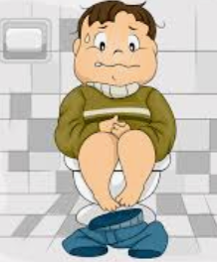
Common Causes of Organic Constipation
Hypothyroidism
Pseudo obstruction or rectal tumors
Neurologic conditions such as Cerebral Palsy
IBD- Inflammatory bowel disease
Diabetes Mellitus
Celiac disease
Dysphagia (inadequate consumption of fiber and fluids)
Congenital disorders such as Tay Sachs, Prader-Willi, Hirschprung Disease, Spina Bifida, Trisomy 13, Down Syndrome
Congestive Heart Failure
Organic Constipation- there is an identifiable condition, disorder or diagnosis causing constipation
(Pashankar, 2005).

Slide 8

Common causes of Functional Constipation
Inadequate fluid intake
Inadequate fiber intake
Disruption of regular diet
Disruption of routine
Inactivity or immobility
Poor body alignment
Absence of upright standing
Consumption of large amounts of dairy products
Stress
Resistance to bowel movements
Overuse of laxatives
Depression
Eating disorders
Functional Constipation- is defined as having no anatomical or genetic defect that is the underlying cause. There is no organic cause (Talley, 2004)

Slide 9
Complications of Constipation
Hemorrhoids
Rectal bleeding
Anal fissures (tears in skin around the anus)
Rectal prolapse (the large intestine detaches inside the body and pushes out of the rectum)
Fecal impaction (hard, dry stool is stuck in the body and unable to be expelled naturally)
Diverticulitis
Notes:
Acute constipation may cause closure of the intestine, which may result in surgery (Forootan, Bagheri, & Darvishi, 2018). The following conditions can also be a result of acute constipation

Slide 10
Fecal Impaction vs Bowel Obstruction
Fecal Impaction
Bowel Obstruction
Fecal impaction occurs when hard, dry stool cannot pass through the colon or rectum. Fecal impaction may be caused by using laxatives too often, using certain types of pain medicines, little or no physical activity over a long period, diet changes, or constipation that is not treated (NCI, n.d.).
A bowel/intestinal blockage or obstruction occurs when something prevents the contents of the intestines from passing normally through the digestive tract. The problem causing the blockage can be inside or outside the intestine.
Notes:
Bowel Obstruction: A tumor, swelling of the intestine, or stool all have the potential to block the inside passageway of the intestine. Outside the intestine, it is also possible for an adjacent organ or area of tissue to pinch, twist or compress a segment of the intestine/bowel, which results in blockage of the intestinal passageway. A bowel obstruction can occur in the small bowel (small intestine) or in the large bowel (large intestine or colon). A bowel obstruction can be total or partial, depending on whether any intestinal contents can pass through the obstructed area.

Slide 11
Signs & Symptoms
Fecal Impaction
Bowel Obstruction
Constipation.
Rectal discomfort.
Anorexia
Nausea and vomiting
Abdominal pain
Paradoxical diarrhea (Liquid stool leaks around the fecal mass, imitating incontinence)
Urinary frequency and/or urinary overflow incontinence.
Abdominal distention and tenderness.
Fever.
Cramping.
Abdominal pain.
Nausea and vomiting.
No gas passing through the rectum.
A “tight” or firm and/or bloated abdomen, sometimes with abdominal tenderness.
Rapid pulse and rapid breathing during episodes of cramps.
Colon tumor
Diarrhea resulting from liquid stool leaking around a partial bowel obstruction.
Notes:
Signs and Symptoms of a Bowel/Intestinal Obstruction can be any Combination of the Following
Abdominal pain, generally coming in intense waves that strike at intervals of five to 15 minutes. Pain may occur in the navel area, or between the navel and the rib cage. Pain that becomes constant may be a symptom of bowel strangulation.
The potential complications of a bowel obstruction are many including electrolyte imbalances, (which can alter sodium and potassium levels and can lead to metabolic alkalosis or acidosis), dehydration, jaundice, intestinal perforation, tissue necrosis, infection, septicemia or death. If the bowel obstruction leads to vomiting, this can also result in aspiration of fecal material into the lungs, which can lead to pneumonia or death (Smith & Escude, 2015). Constipation at the time of obstruction, and intermittent bouts of constipation that have occurred several months beforehand.
Colon tumor is the cause of the problem, a history of rectal bleeding (such as streaks of blood on the stool).

Slide 12

Importance of reporting change
Prevalence of constipation in the general population is difficult to ascertain due to inaccurate reporting. (Garrigues, et al., 2004) estimates that the general public has an incidence rate between 2%-34%. The incidence among females and elderly are higher (Garrigues, et al., 2004).
Prevalence of constipation within the intellectual disability population is as high as 50% (Robertson, Baines, Emerson, & Hatton, 2017). Increase in behaviors can also be an indication of constipation.
Any changes noted in bowel habits should be reported. Individuals that take medications for constipation should be monitored. To report a change contact the nurse. If nursing is not available, contact the PCP or an Urgent Care if issue is found on a weekend. Delay in seeking care can result in complications.

Slide 13
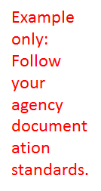
DSP's connect the dots....
Situation: James lives with his parents. His communication skills are limited. He is incontinent of bowel and bladder and requires total assistance with hygiene. He has a history of chronic constipation and fecal impaction. The PCP has ordered Miralax daily to help soften and promote bowel movements. James' mother does not like to give Miralax because it makes hygiene more difficult and he often will have leakage from his adult brief. She prefers that it remain hard. James attends day support.
Way to go DSP! You recognized a change in status.
Example of a progress note: 4/16/20 8:20am James arrives at DS with a frown on his face. Staff asked his mother about bowel movements in the last 2 days, since he has not had one while at DS. His mother states, he has not had one at home since last Friday, today is Wednesday. Mother states that she had not given him Miralax either. James' stomach appears bloated and he is refusing all food and drink. Staff reported to DS manager.

Slide 14
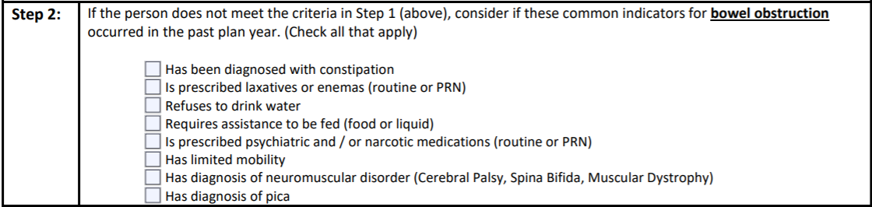
DSP's connect the dots...
Use the RAT tool to help staff recognize risks and prompt changes within plans and support instructions. The RAT can help providers be proactive.
You are the boots on the ground! Based on your daily observations you may recognize a change in status that would require evaluation. If you notice any of the risk factors listed below for bowel obstruction, report and document quickly.

Slide 15
Caregiver Recommendations
The main management response to constipation in people with intellectual disability is laxative use, despite limited effectiveness. An improved evidence base is required to support the suggestion that an individualized, integrated bowel management program may reduce constipation and associated health conditions in people with intellectual disability (Robertson, Baines, Emerson, & Hatton, 2017).
Initiate a bowel management program that includes:
1) Having a consistent schedule in place for taking medicines regularly to prevent or relieve constipation
2) Monitoring of bowel movement frequency, consistency, and volume.
3) Documenting the findings of monitoring by utilizing a tool such as a bowel diary to record stool frequency and consistency.
Discuss treatment strategies with the individual’s primary care physician (PCP), including implementation of a bowel management guideline or protocol to ensure the individual receives the prescribed treatment and proper monitoring for prevention of complications.

Slide 16
Diagnosis
Diagnosing of constipation may require physical exams, lab tests and bowel monitoring. The following questions are usually considered, when observing a person’s condition and treatment options:
What is the individual’s normal bowel habits?
How long has the individual had difficulty with bowel movements?
When was the last time the individual had a bowel movement?
Is the individual passing gas?
Does the individual complain about abdominal or rectal pain when defecating/having a bowel movement?
Does the individual grimace or appear to be in pain when they are defecating/having a bowel movement?
Always contact the primary care physician (PCP) if the individual has not had a bowel movement in 3 days.

Slide 17
Diagnostic Tests
Diagnostic Tests
A general physical exam.
A digital rectal exam.
Blood tests. The primary care physician (PCP) might check for an underlying condition such as low thyroid levels (hypothyroidism) (Mayo Clinic, 2018).
Examination of the rectum and lower or sigmoid colon (sigmoidoscopy).
Examination of the rectum and entire colon (colonoscopy).
Evaluation of anal sphincter muscle function (anorectal manometry).
MRI (magnetic resonance imaging).

Slide 18

Prevention is key
Ensure that individuals are receiving high-fiber foods in diet (according to recommendations of 20-35grams per day)
Avoid eating highly processed foods with low fiber content
Drink plenty of fluids
Stay active and plan activities that promote movement
Assist individuals to establish a schedule (encourage bathroom breaks 20-30 minutes after meals)
Allow plenty of time for bathroom breaks
Follow positioning protocol to promote natural bowel motility
Administer stool softeners and/or laxatives as prescribed by PCP
Track bowel movement frequency, consistency, and volume. (See note)
*A constipation protocol should be established for individuals taking stool softeners, laxatives on a routine basis or history of bowel obstruction.*
Notes:
Instructor: Handout available for example of a seating protocol

Slide 19

Case Study
Meet Joey. He is 34 years old with limited verbal communication. He has a diagnosis of Cerebral Palsy, Autism, constipation. He is incontinent of bowel and bladder.
Today Joey’s mother calls you to report that he is very agitated, biting her when she gets close, and refusing to eat or drink. She asks if REACH would be able to help her with his behavior. You ask if she has taken his temperature or if he appears to be in pain. She replies that he is angry with her and will not allow her to touch him. Since you have a good relationship with Joey, you tell her you will come by the home shortly.
Upon arrival you notice that Joey is very agitated and grimacing. You talk to him in a soothing voice and he allows you to touch his hand. His skin feels normal temperature. You notice a Miralax container sitting on the counter, and ask the mother if Joey has taken his medications today. She states “yes, but I only give him Miralax when he gets really constipated.” You ask about his last bowel movement and she is unable to recall, but states she prefers for his stool to be less messy and easier to clean up. You notice that Joey’s stomach looks bloated, you try to gently rub his stomach and he reacts by trying to bite you.

Slide 20

Apply what you have learned
State (3) caregiver recommendations to avoid the complications of constipation the Individual experienced in the case study.
1.______________________
2.______________________
3.______________________

Slide 21
SC's connect the dots with the RAT Tool...
SC's- as you are completing the RAT tool keep in mind there are key diagnoses and situations you need to incorporate in discussion with providers and caregivers to ensure risk factors are being recognized.
Positioning Protocol –does the individual use a stander?
Bowel Management Program
Hydration Status-does the individual require prompting to drink?
RAT TOOL
Medications: Antidepressants, Opioids, Calcium Channel Blockers, Iron supplements, Anticholinergics, Diuretics, and NSAIDS.
Postures that indicate the person is withholding stool (standing on tiptoes and then rocking back on the heels of the feet, clenching buttocks muscles, other unusual “dancelike” behaviors.
Laxative Use –how often are PRN's being used for constipation
Rectal Prolapse
Rectocele
Anal Fissure
Colon Cancer
Behaviors
Increase in self-injurious behaviors.

Slide 22
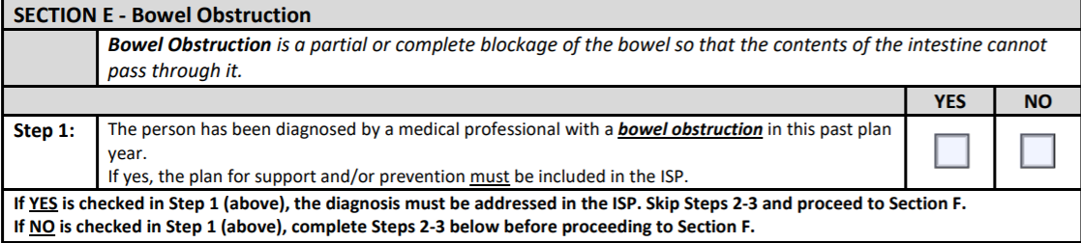
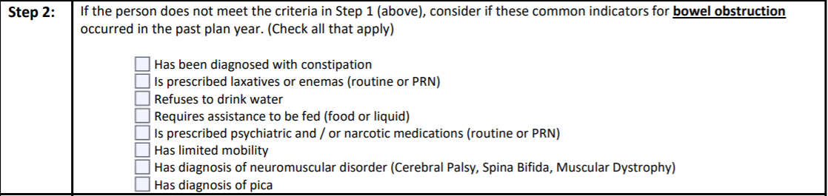
Prior to ISP meeting, review discharge summaries, medical reports, and health history for information.
Follow these steps to success…
Remember! Think about all settings: home, Day Support, Community Engagement
Skip Step 2 and go to Section F

Slide 23
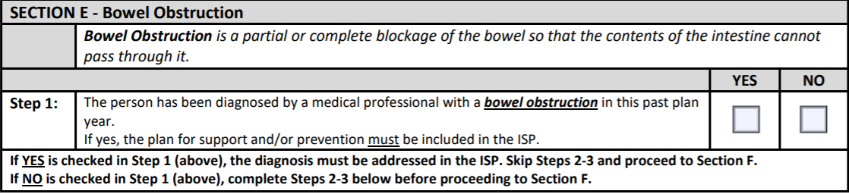
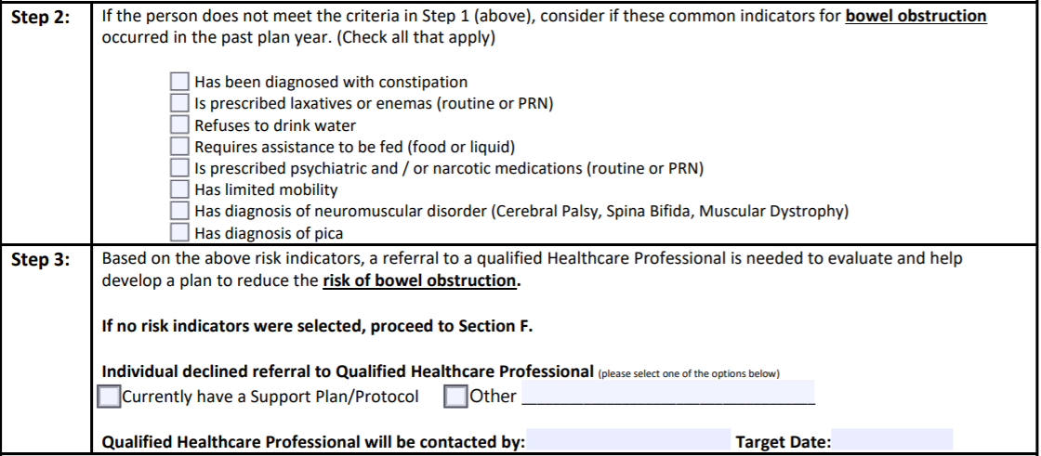
Follow these steps to success…
During the ISP meeting ask all participants if they are aware of any risk factors listed in Step 2
Dr. Hopewell
Nov 15, 20

Slide 24


Slide 25
References
Charlot, L., Abend, S., Ravin, P., Mastis, K., Hunt, A., & Deutsch, C. (2010). Non-psychiatric health problems among psychiatric inpatients with intellectual disabilities. Journal of Intellectual Disability Research, 55(2), 199–209. Retrieved from: https://www.ncbi.nlm.nih.gov/pmc/articles/PMC3646333/
Cleveland Clinic. (2019). Improving your health with fiber. Retrieved from https://my.clevelandclinic.org/health/articles/14400-improving-your-health-with-fiber
Forootan, M., Bagheri, N. & Darvishi, M. (2018). Chronic constipation: A review of literature. Medicine, 97(20). Retrieved from https://www.ncbi.nlm.nih.gov/pubmed/29768326
Garrigues, V., Gálvez, C., Ortiz, V., Ponce, M., Nos, P., & Ponce, J. (2004). Prevalence of Constipation: Agreement among Several Criteria and Evaluation of the Diagnostic Accuracy of Qualifying Symptoms and Self-reported Definition in a Population-based Survey in Spain. Am J Epidemiol, 159, 520-526.
Lewis, S. J., & Heaton, K. W. (1997). Stool form scale as a useful guide to intestinal transit time. Scandinavian Journal of Gastroenterology, 32(9), 920-924. Retrieved from https://www.nice.org.uk/guidance/cg99/resources/cg99-constipation-in-children-and-young-people-bristol-stool-chart-2
Mayo Clinic. (2018). Constipation. Retrieved from https://www.mayoclinic.org/diseases-conditions/constipation/symptoms-causes/syc-20354253
Mayo Clinic. (2019). Nutrition and healthy eating: Dietary fiber essential for a healthy diet. Retrieved from: https://www.mayoclinic.org/healthy-lifestyle/nutrition-and-healthy-eating/in-depth/fiber/art-20043983
National Institute on Aging (NIA). (2013). Concerned About Constipation? https://www.nia.nih.gov/health/concerned-about-constipation
National Cancer Institute (n.d). NCI Dictionary of Cancer Terms, Fecal Impaction. Retrieved from https://www.cancer.gov/publications/dictionaries/cancer-terms/def/fecal-impaction

Slide 26
References
National Institute of Diabetes and Digestive and Kidney Diseases (n.d.). Let’s talk about bowel control. Retrieved from file:///C:/Users/dha92624/Downloads/Stool_Diary_508.pdf
Nikjooy, A., Jafari, H., Saba, M., Ebrahimi, N., Mirzael, R. (2018). Patient assessment of constipation quality of life questionnaire: Tradition, cultural adaptation, reliability and validity of the Persian version. Iran J Med Sci 43(3), 261-268.
Pashankar, D. S. (2005). Childhood constipation: evaluation and management. Clinics in colon and rectal surgery, 18(2), 120–127. doi:10.1055/s-2005-870894
Robertson, J., Baines, S., Emerson, E. & Hatton, C. (2018). Constipation management in people with intellectual disability: A systematic review. Journal of Applied Research in Intellectual Disabilities, 31(5), 709-724. Retrieved from https://onlinelibrary.wiley.com/doi/abs/10.1111/jar.12426
Smith, M. A. & Escude, C. L. (2015). Intellectual and developmental disabilities. Clinical Advisor, 18(2), 48–59. Retrieved from https://www.clinicaladvisor.com/home/cme-ce-features/intellectual-and-%E2%80%A8developmental-disabilities/2/
Talley, N. J. (2004). Definitions, epidemiology, and impact of chronic constipation. Reviews in Gastroenterological Disorders, 4, S3-S10.
UVA Children’s (n.d.). Constipation in Children. Retrieved from https://childrens.uvahealth.com/services/pediatric-digestive-health/constipation

