Slide 1

Falls
Risk Awareness Training (RAT)
Presented by:
The Virginia Department of Behavioral Health and Developmental Services
The Office of Integrated Health
Health Supports Network, September 2019

Slide 2
Who benefits from this training
DSP's and caregivers- you will learn important risk factors associated with falls, learn to recognize signs and symptoms of injuries after falls, and the importance of reporting.
Support Coordinators-you will learn important risk factors associated with falls, understand the signs and symptoms that DSP's and caregivers are going to recognize and provide in documentation, and learn diagnosis that may be associated with risk factors.

Slide 3
Objectives
At the conclusion of this training, participants will be able to …
Define the term “fall”.
List the (3) possible complications of a fall.
Identify (3) risk that increases an Individual's risk for falls.
Provide (2) fall facts
Recognize (2) sign of a serious injury
List (3) ways to prevent falls

Slide 4
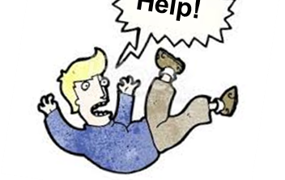
What is a Fall?
A fall is any situation in which someone descends (or falls) suddenly and involuntarily toward a lower surface or the ground.
Fall complications can include broken bones, head injuries, soft tissue damage, and problems with daily activities (VCU, 2016).
Notes:
DBHDS CHRIS system Definition
Needs a citation.
Virginia Commonwealth University (2016). Orientation Manual for Direct Support Professionals (DSPs) and Supervisors: Supporting people in their homes and communities. Retrieved from https://partnership.vcu.edu/DSP_orientation/downloadables/SECTION%206_07222016.pdf

Slide 5
Fall Facts
In People with ID/DD
According to research conducted by Hsieh, Rimmer, Heller, Minor and Grosso in 2014:
One in five adults (18 – 44) with ID/DD reported falling in the past year.
One in three middle-aged adults (45-64) with ID/DD reported falling in the past year.
Nearly 25% of fall – related injuries needed medical attention.
Notes:
Policy to Practice: Falls in Adults with Intellectual Disabilities; article
4 Hsieh K., Rimmer J. H., & Heller T. (2014) Prevalence of falls and risk factors in adults with intellectual disability. American Journal on Intellectual and Developmental Disabilities, 117, 442-454
Hsieh, K., Rimmer, J., & Heller, T. (2012). Prevalence of falls and risk factors in adults with intellectual disability. American journal on intellectual and developmental disabilities, 117(6), 442-454.

Slide 6

Age
Polypharmacy
Seizure Disorder
Uses an assistive device for mobility.
Females have a higher prevalence of falls than males.
Arthritis
Risk Factors
Notes:
Policy to Practice: Falls in Adults with Intellectual Disabilities; article
4 Hsieh K., Rimmer J. H., & Heller T. (2014) Prevalence of falls and risk factors in adults with intellectual disability. American Journal on Intellectual and Developmental Disabilities, 117, 442-454
Hsieh, K., Rimmer, J., & Heller, T. (2012). Prevalence of falls and risk factors in adults with intellectual disability. American journal on intellectual and developmental disabilities, 117(6), 442-454.

Slide 7

Signs of serious injury after falling
Inability to move-decreased ROM
Difficulty breathing/labored breathing/Not breathing
Lack of responsiveness
Individual that can usually ambulate cannot bear weight
Swelling, redness of any body part after a fall
Individual is expressing pain or staff recognize non-verbal ques of pain
Extremity (arms, legs, feet, hands) appear deformed
Leg length differs
Bruising
Guarding (refusing to be touched or moved)
Bone protruding through skin

Slide 8

Situations that require further evaluation
Fall occurs from a height (porch, ramp)
Fall occurs from a vehicle lift or patient lift
Individual uses DME equipment to ambulate or move (Cane, wheelchair, gait trainer, lift, stander, bed, powerchair)
Fall occurs while exiting a vehicle or is thrown from a vehicle during an accident.
Fall occurs on stairs
Fall occurs after a hospitalization
Fall occurs after a health status change

Slide 9
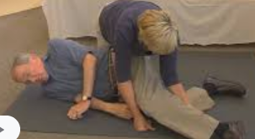
Complications of Head injuries
Severe head or facial bleeding.
Bleeding or fluid leakage from the nose or ears.
Severe headache.
Any change in level of consciousness.
Black-and-blue discoloration below the eyes or behind the ears.
Cessation of breathing.
Confusion.
Loss of balance.
Weakness or an inability to use an arm or leg.
Unequal pupil size.
Slurred speech.
A seizure.
Vomiting.
Call 911 or your local emergency number if any of the following signs or symptoms are apparent after a fall, because they may indicate a more serious head injury (Mayo Clinic, 2019a,b): ​
Indicators of Serious Head Injury in Adults​
Notes:
Mayo Clinic (2019a). Cuts and scrapes: First aid. Retrieved from https://www.mayoclinic.org/first-aid/first-aid-cuts/basics/art-20056711
Mayo Clinic (2019b). Head trauma: First aid. Retrieved from https://www.mayoclinic.org/first-aid/first-aid-head-trauma/basics/art-20056626

Slide 10
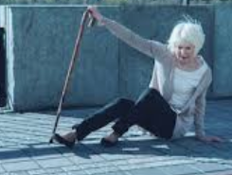

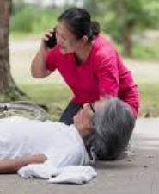
Falls are no joke.... Call 911!
After a fall - don’t wait. Inform the team members on the individual’s care team, as soon as possible. The individual might need additional supports to limit and/or reduce their risk for a serious injury due to another fall.​

Slide 11

Importance of reporting change
Changes to health status after emergency room, Urgent Care, and hospitalizations can cause falls. This change in status can increase the risk for falls once the individual is back home or regular activities
Any fall with or without injury should documented and reported to the manager of the service, Support Coordination and other providers of service so that everyone is aware of the event and implementing precautions and interventions.
Document your findings in daily note and who it was reported to.
Be sure to follow up with the individual’s Primary Care Provider (PCP) or licensed healthcare provider (ex. Nurse or Physical Therapist) to discuss their risk for falls.

Slide 12
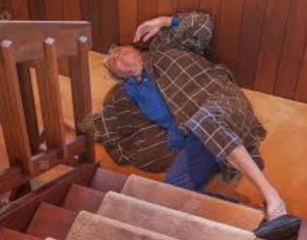
DSP connect the dots......
Situation: An individual fell down three steps face forward and lands hitting his head on the floor. He has a swollen area above the right eye. He is breathing but eyes are closed, and he is not moving.
Way to go DSP, you recognized an emergency!
Example only: Follow your agency documentation standards.
Example of a daily note: 4/10/20 While out with community engagement at a small shop, individual fell down three steps. He hit his head and did not respond to his name for a few seconds. Just above his right eye started to swell. 911 was immediately called. Staff stayed with the individual and monitored his breathing. By the time EMS arrived he was responding to voice commands and trying to get up. Staff asked him to remain lying on the floor until he was evaluated. He was taken to the ER due to hitting his head. DSP notified Day Support Manager.

Slide 13
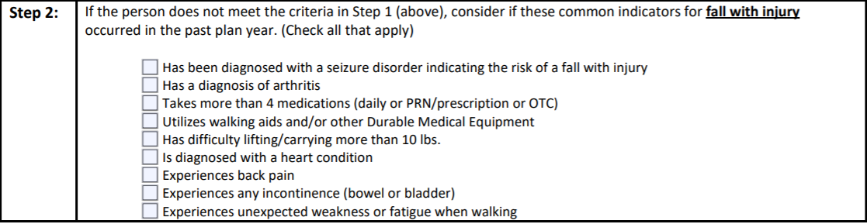
DSP's connect the dots...
Use the RAT to assist staff be aware of risks and also prompt changes within plans and support instructions. The RAT can help providers be proactive.
You are the boots on the ground! Based on your daily observations you may recognize a change in status that your prompt evaluation. If you notice any of the risk factors listed below for falls, report and document quickly.

Slide 14

Fall Prevention is Key
Encourage using handrails
Wear non-skid shoes
Clean up spills immediately
No loose cords in walkways
Have vision checked yearly
No small rugs
Beware of pets
No clutter in walkways
Encourage use of DME equipment
Monitor medication side effects
Grab bars in bathroom
Non-slippery surfaces in showers/tubs (CDC, 2019)

Slide 15
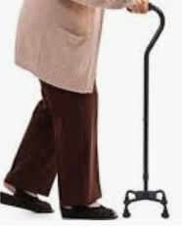
Case Study
Gabby has experienced numerous falls over the years. She has suffered many broken bones due to falls. She struggles to maintain her balance getting up to stand and she has an unusual gait which seems almost as if she walks sideways. Gabby has excellent perception skills; however, she communicates by making sounds and hand gestures. She is most successful ambulating when she has staff with her that are familiar with her ques and how to assist her with walking.
Today there are several out sick at Day Support. Gabby has Group Day hours as well as Community Engagement hours. Gabby is scheduled to go out with a seasoned staff person, but this staff is unfamiliar with ambulation supports. The staff takes Gabby's travel chair since they are going to Gabby's favorite activity of helping at the food bank.
They arrive at the food bank. The staff parks the van and attempts to assist Gabby out of the vehicle. Gabby keeps her left arm folded up on her chest and uses her right hand to manage her cane. Gabby tries to communicate that they left her cane back at the center. The staff is unsure of Gabby's message and continues to assist her out of the vehicle. Gabby gets scared and starts falling forward. The staff support Gabby's weight, but she does have a bruise on her side from hitting the van door. Gabby indicates she is Ok, but later that night she ends up at the ER.

Slide 16
Apply what you've learned
List three interventions that would have prevented this fall from occurring.
1. ____________________________
2. _____________________________
3. _____________________________

Slide 17
SC's connect the dots...
SC's- as you are completing the RAT tool keep in mind there are key diagnoses and situations you need to incorporate in discussion with providers and caregivers to ensure risk factors are being recognized.
OT/PT evaluation?
Visual changes
Loss of vision
Orthostatic Hypotension
Ataxia
Congestive Heart Failure
(edema in the legs)
Dehydration
RAT TOOL
Heart Arrythmias
Dementia
Osteoporosis
Unfamiliar with environment
Are more or different supports needed?
Diabetes
(Hypoglycemia)

Slide 18
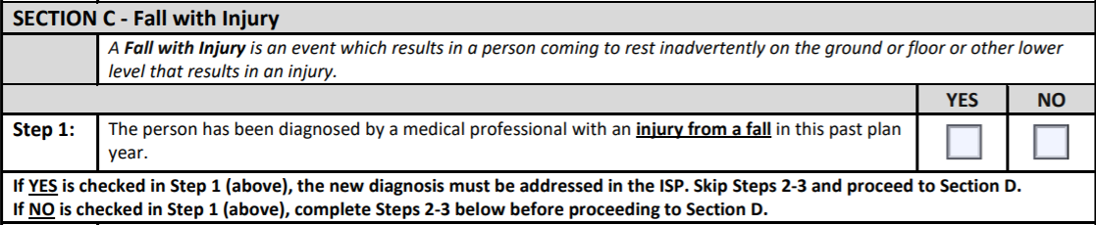

Remember! Think about all settings: home, Day Support, Community Engagement
Follow these steps to success…
Prior to ISP meeting, review discharge summaries, medical reports, and health history for information.
Skip Step 2 and go to Section D

Slide 19
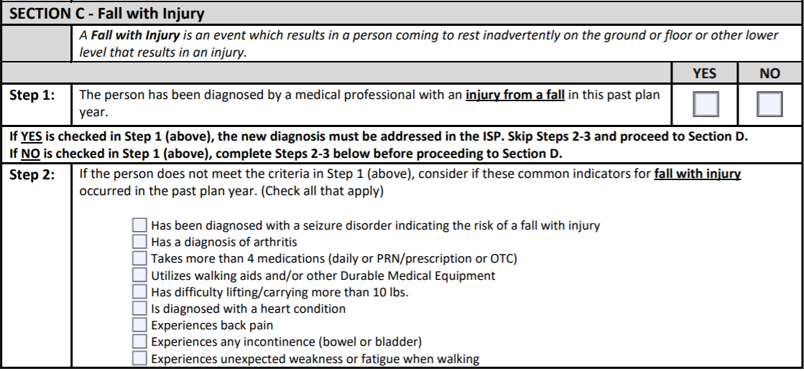
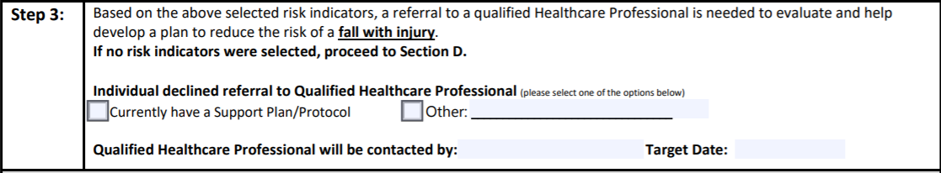
Follow these steps to success…
During the ISP meeting ask all participants if they are aware of any risk factors listed in Step 2
Dr. Hopewell
Nov 15, 20

Slide 20

Who Can Help Plan?
There are a number of healthcare professionals that can provide assessment and prescription for treatment to reduce the risk of possible adverse events (Hsieh, Rimmer, Heller, Minor and Grosso in 2014).
They include:
  Primary Care Practitioner (PCP).
  Orthopedist.
  Podiatrist.
  Neurologist.
  Ophthalmologist.
  Ear, Nose & Throat Specialist.
Notes:
Hsieh, K., Rimmer, J., & Heller, T. (2012). Prevalence of falls and risk factors in adults with intellectual disability. American journal on intellectual and developmental disabilities, 117(6), 442-454.

Slide 21
Who Else Can Help?
Other healthcare professionals that can assess and provide a care plan (in their specialty) addressing the prescribed treatment(s) to reduce the risk of falls, include:
  Registered Nurse (RN).
  Licensed Practical Nurse (LPN) – per VA BON Regulations.
  Pharmacist.
  Physical Therapist (PT).
  Occupational Therapist (OT).
  Certified Therapeutic Recreation Specialist (CTRS).
  Behavioral Support Professional (BCBA, BSP).
  (Hsieh, Rimmer, Heller, Minor and Grosso in 2014).
Notes:
Hsieh, K., Rimmer, J., & Heller, T. (2012). Prevalence of falls and risk factors in adults with intellectual disability. American journal on intellectual and developmental disabilities, 117(6), 442-454.

Slide 22
References & Resources
American Academy of Pediatrics (2018). Concussion management: Return to play. Retrieved from https://www.aap.org/en-us/advocacy-and-policy/state-advocacy/Documents/Concussion.pdf
American Medical Society for Sports Medicine (2005). Sport Concussion Assessment Tool. Retrieved from http://www.amssm.org/MemberFiles/SCAT_v13-_Side_2.doc
American Red Cross (2016), Traumatic injuries (pp. 110-111). First Aid/CPR/AED Instructors Manual. USA: Staywell.
Bhangu, J., McMahon, C. G., Hall, P., Bennett, K., Rice, C., Crean, P., ... & Kenny, R. A. (2016). Long-term cardiac monitoring in older adults with unexplained falls and syncope. Heart, 102(9), 681-686.
Brain Injury Association of Virginia (2013). Brain injury and the schools: A guide for educators. Retrieved from http://www.doe.virginia.gov/special_ed/disabilities/traumatic_brain_injury/brain_injury_schools.pdf
Brain Injury Association of Virginia (2019). Concussion: Mild traumatic brain injury in the elderly. Retrieved from https://www.biav.net/?s=concussion
Careerforce (2017). Learning guide: Observe and respond to changes. Retrieved from: https://library.careerforce.org.nz/Learning%20Assessment%20Resources/LG27459-2.1.doc
Center for Disease Control and Prevention. (2017). Home and recreational safety: Important facts about falls. Retrieved from https://www.cdc.gov/homeandrecreationalsafety/falls/adultfalls.html
Centers for Disease Control and Prevention (2013). What is a concussion? Retrieved from https://www.youtube.com/watch?v=Sno_0Jd8GuA&feature=youtu.be

Slide 23
References & Resources
Centers for Disease Control and Prevention, (2019c). Heads up. Retrieved from https://www.mayoclinic.org/first-aid/first-aid-head-trauma/basics/art-20056626
Centers for Disease Control and Prevention, National Center for Injury Prevention and Control. (2019d). Web–based injury statistics query and reporting system (WISQARS).
Children’s Hospital of the King’s Daughters (CHKD) (2019). Could it be a concussion? Retrieved from https://www.chkd.org/Patients-and-Families/Health-Library/Quick-Tips/Could-It-Be-A-Concussion-/
Children’s National Health System (2019). Concussion FAQ’s. Retrieved from https://childrensnational.org/departments/center-for-neuroscience-and-behavioral-medicine/programs-and-services/safe-concussion-outcome-recovery--education-score-program/concussion-faqs
Gioia, G. and Collins, M. (2005). Acute concussion evaluation. Retrieved from https://www.cdc.gov/headsup/pdfs/providers/ace-a.pdf
Hsieh, K., Rimmer, J., & Heller, T. (2012). Prevalence of falls and risk factors in adults with intellectual disability. American journal on intellectual and developmental disabilities, 117, 442- 454.
Mayo Clinic (2019a). Cuts and scrapes: First aid. Retrieved from https://www.mayoclinic.org/first-aid/first-aid-cuts/basics/art-20056711
Mayo Clinic (2019b). Head trauma: First aid. Retrieved from https://www.mayoclinic.org/first-aid/first-aid-head-trauma/basics/art-20056626
Office of Integrated Health, Virginia Department of Behavioral Health and Developmental Services (n.d.). Documenting changes in a person’s status. Retrieved from http://www.dbhds.virginia.gov/library/quality%20risk%20management/qrm-documenting%20changes%20in%20medical%20condition.pdf

Slide 24
References & Resources
Virginia Board of Education (2016). Virginia Board of Education guidelines for policies on concussions in students. Retrieved from http://www.doe.virginia.gov/boe/guidance/health/2016-guidelines-for-policies-on-concussions-in-students.pdf
Virginia Commonwealth University (2016). Orientation Manual for Direct Support Professionals (DSPs) and Supervisors: Supporting people in their homes and communities. Retrieved from https://partnership.vcu.edu/DSP_orientation/downloadables/SECTION%206_07222016.pdf
Virginia Department of Behavioral Health and Developmental Services (DBHDS), Commonwealth of Virginia Government (2016). Orientation manual for direct support professionals (DSPs) and supervisors: supporting people in their homes and communities [Brochure]. Retrieved from https://partnership.vcu.edu/DSP_orientation/downloadables/DSP%20Orientation%20Manual%20-%20REVISED_08102016_with%20test_effective%20date09012016.pdf
Virginia Department of Health (2019). Concussion: What is a concussion? Retrieved from http://www.vdh.virginia.gov/traumatic-brain-injury/concussions/

